Slide 1
Repeated implantation failure ( RIF )
Dr. afsoon zarei
Infertility Fellowship Associated prof. of Shiraz University of Medical Science

Slide 2
INTRODUCTION:
Implantation is the first step of crosstalk between the embryo and endometrium, which is the key point for a successful pregnancy. This process includes apposition, adhesion, and invasion.
Successful implantation is identified as an intrauterine gestational sac seen on ultrasonography. Implantation failure may occur during the attachment and migration process, with a negative urine or blood test for (hCG) or failure to form an intrauterine gestational sac with positive hCG.
Recurrent implantation failure (RIF) is a clinical phenomenon with no universally accepted definition. The key factors that need to be considered while establishing the definition of RIF are the number of embryos transferred or unsuccessful in vitro fertilization-embryo transfer (IVF-ET) cycles, the quality of embryos, fresh or frozen embryos, and maternal age, which are disputed points.

Slide 3
DEFINITION OF RIF:
RIF was historically defined by absence of implantation after three or more transfers of high-quality embryos or after transfer of more than 10 high quality embryos in multiple cycles.
When referring to PGT-A cycles,RIF can be defined as lack of implantation after transfer of more than 3 high morphologic quality euploid blastocysts.
A recent comprehensive survey of the definitions in use that employ this paradigm has suggested that a consensus is emerging that regards RIF as the failure to achieve a clinical pregnancy after two to three transfers with good-quality embryos and that maternal age should also be taken into account (Cimadomo et al., 2021
Definitions can serve as guides to demarcate this challenging patients and make a decision for treatment strategies

Slide 4
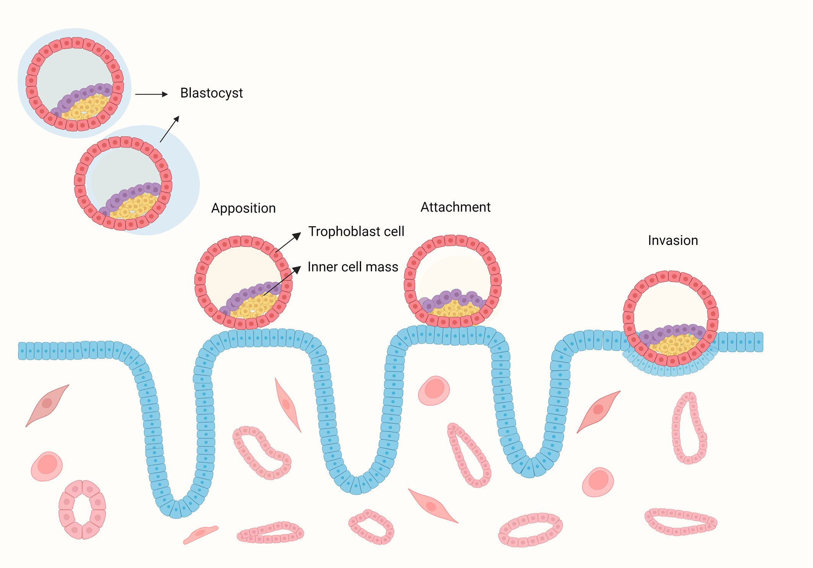
The blastocyst hatches from the zona pellucida and contact with the endometrium, then the embryo bind to the endometrium during the attachment stage, during with the crosstalk between the embryo and endometrium induces up-regulation of surface receptors and the secretion of signaling molecules and hormones. This signaling directs epithelial withdrawal and trophoblast invading the endometrium.

Slide 5
Estimating the chance of implantation:
The likelihood of successful implantation after ART is determined by a multitude of factors including, but not limited to, female factors such as age, hormonal levels, endometrial and uterine status and underlying conditions, embryo factors such as embryonic cleavage speed, euploidy, and previous implantations of sibling embryos, male factors like genetic disorders, and external factors such as the performance of the laboratory and clinic, transfer policies, and legal restrictions.

Slide 6
Figure 2:Applying the recommended definition of RIF in clinical practice

Slide 7
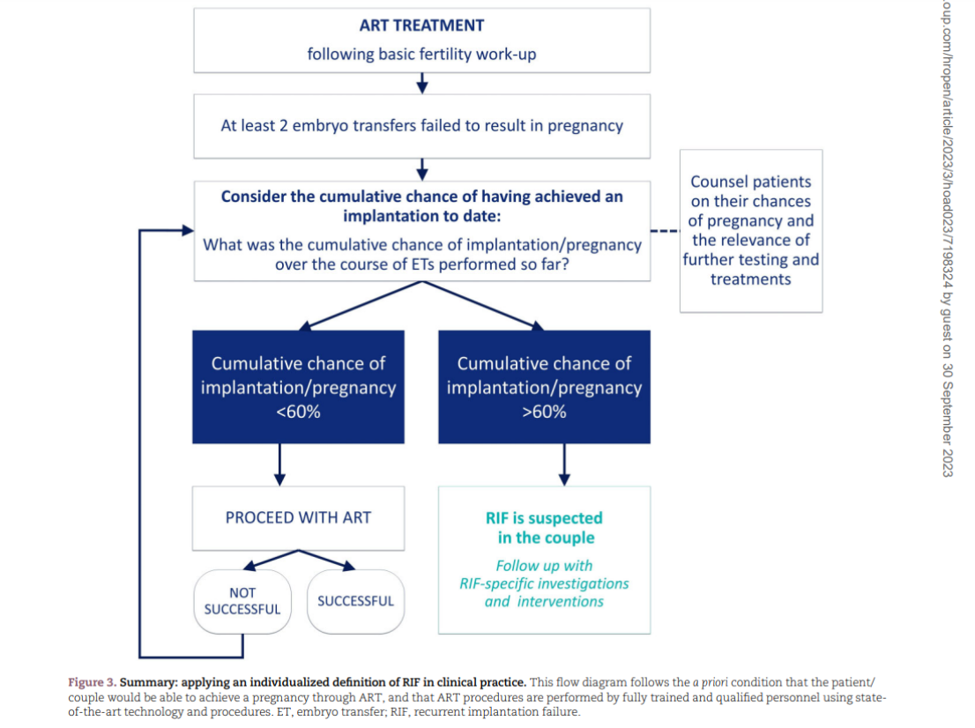

Slide 8
Risk factors for rif:
1. Body mass index
BMI is associated with implantation. Pre-pregnancy obesity is associated with abnormal menstruation, anovulation, and pregnancy complications . In IVF-ET, obese patients tend to have a lower pregnancy rate.
when BMI was ≥ 30 kg/m2, patients undergoing IVF-ET had significantly decreased odds of implantation.
In addition, obesity can alter the markers of uterine receptivity and decidualization, which may contribute to a decrease in the implantation rate in obese patients.
2. Smoking
for patients who smoked for > 5 years, smoking was associated with fewer oocytes retrieved, a higher cycle cancellation rate, and a lower implantation rate.
3.Alcohole
4.Stress

Slide 9
Investing female factors:
Lifestyle factors
Screening for genetics factor
Anatomical investigation (Uterine pathology/Tubal pathology)
Microbiome profile
Endocrine factors
Immunological screening
Thrombophilia screening

Slide 10
LIFE STYLE FACTORS
While lifestyle factors have been investigated during the
fertility workup, patient behaviors can change so it is
recommended to review these and their optimization
when RIF is encountered.
There are insufficient data to recommend the routine
measurement of vitamin D levels or treatment of vitamin D deficiency

Slide 11
Screening for genetics factor:
In a observations, case–control studies have shown that karyotype anomalies are more frequent in patients with RIF, even if the absolute prevalence (2.1%) is low.
Despite the low prevalence, karyotyping can be considered to confirm the absence of a chromosomal abnormality in parents.
If a chromosomal abnormality is detected, genetic
counselling and, where relevant, preimplantation genetic testing (PGT), is recommended

Slide 12
Uterine pathology:
Uterine fibroid, polyp, Asherman's syndrome, adenomyosis, uterine malformations, endometrial atrophy are widely considered relevant in RIF.
The incidence of unrecognized uterine pathology in patient with RIF may be elevated (25-50%)
HOXA-10 and HOXA-11 are transcription factors that involved in regulation of various aspect of endometrial receptivity. They are highly expressed in endometrium during the secretory phase and their expression is regulated by progesterone
The endometrium overlying myomas has altered expression of HOXO-10 andTGF-B3 so impaired receptivity.

Slide 13
It is accepted that subserosal myomas do not affect pregnancy outcomes, but submucosal myoma decreased pregnancy rate so removal of them is beneficial.
There is no clear evidence that removal of non distorting intramural myomas >2cm increased pregnancy outcomes.
Polyps maybe a cause of implantation failure sand multiple studies reported improved conception after resection.
Previous uterine instrumentation specially those who complicated with pelvic infection should be role out intrauterine adhesion .
Adenomyosis is another potential cause of RIF. And defined by endometrial glands invasion of the myometrium.
Though adenomyosis has negative effect on fertility and pregnancy outcomes, it is one of the least treatable uterine pathology.
Limited success reported in utilization of GnRH agonist as a pretreatment in RIF patients.

Slide 14
Assessment of uterine cavity:
According to diagnostic accuracy of 3D transvaginal ultrasound, it has been proposed as an alternative noninvasive procedure for the diagnosis of uterine abnormality.
If 3D ultrasound has not been performed at fertility workup, it can be considered in patient with RIF
If adenomyosis, endometriosis, and submucosal fibroids should be carried out before ART, if there is suspicion owing to emerging clinical signs or Sono features noted after RIF, then further investigations including MRI or DX laparoscopy should be considered.
Hysteroscopy can be considered, especially when there is a suspicion of a uterine anomaly visualized on TVS.
polypectomy, submucous fibroids, septum resection, or removal of intrauterine adhesions are established for treatment of symptoms, but their impact LBRs has not been evaluated in patients with RIF

Slide 15
2.Endometrial function and receptivity:
Molecular or transcriptomic testing of endometrium is an emerging strategy for RIF.
Research has suggested that patients with RIF have high level of pro inflammatory markers (IL-22,resistin ,leptin)and altered T-cells.
Transcriptomic studies suggest that endometrial expression profile in patient with RIF is altered.
Diaz-Gimeno et al. developed endometrial receptivity array(ERA) examining 238 endometrial genes and it require endometrial BX at the time of potential transfer either in natural cycle or programmed cycle.
None-receptive results received recommendation for altered length of progesterone exposure.
There are insufficient data to recommend the routine use of any available test of endometrial receptivity to diagnose the cause of RIF, assessment of specific aspects of endometrial function by testing can be considered. But there no single acceptable test.

Slide 16
3.Investigating chronic endometritis:
Chronic endometritis should be excluded in patient with RIF with out apparent causes. This is associated with reduction of receptivity and lymphocyte dysregulation and abnormal expression of cytokines. There is enough evidence either perform BX or empirical TX .
Assessment for chronic endometritis (CE) can be considered and treatment with antibiotics can be considered.
Revision of this recommendation may be indicated should studies using more standardized diagnostic techniques, including the emerging DNA-based tests, reveal a clearer benefit.

Slide 17
4. Re-assessment of endometrial thickness:
A recent systematic review showed the association between endometrial thickness and LBR in fresh cycles reported that women with a thin endometrium (EMT < 7 mm) had a significantly lower LBR(Liao et al., 2021)
Re-assessment of endometrial thickness is recommended. A review of the estradiol treatment regimen is recommended if the endometrium is noted to remain thin. Hysteroscopy to rule out Asherman’s syndrome can be considered.

Slide 18
Tubal pathology:
In patient with RIF tubal pathology must also be excluded.
Mechanism of adverse effects of hydrosalpinx is multifactorial. Accumulated tubal fluid may exert a direct embryotoxic effect and may mechanically flush out the embryo or altered endometrial receptivity.
The greatest effect was seen when hydrosalpinx was seen in Sono or when tubal diameter was >3CM in fluoroscopy.
It is advisable to exclude hydrosalpinx in women with RIF ,regardless of initial infertility dx.

Slide 19
Microbiome profile:
Almost 10% of the bacterial population present in the body resides in the female genital tract and Lactobacillus species are part of NL flora (Moreno and et al, 2019). Whether microbial dysbiosis is among the determining factors of implantation failure remains under study, but in clinical practice, 47% of clinicians consider this a relevant factor (Cimadomo et al., 2021)
Based on the currently available data, there are several unanswered questions on the relevance of microbiome testing in RIF so uterine and vaginal microbiome profiling is not recommended.

Slide 20
Endocrinologic factors:
Assessment of thyroid function can be considered during the ART fertility workup or when RIF is detected, but as no specific association with implantation failure has been reported, assessment is not generally recommended as an investigation for RIF
But TFT can be considered
Thyroid autoimmunity, prolactin, free androgen levels or diabetes (HBA1C) are either not addressed or considered not to be relevant in RIF by other guidelines

Slide 21
Progesterone:
There has been growing interest in showing association between premature progesterone rises, measured around the time of triggering oocyte maturation, and clinical outcomes after fresh ET.
There is a view that this can lead to endometrial/embryo asynchrony, meriting delaying ET to a subsequent freeze-thaw cycle (Bosch et al., 2010; Venetis et al., 2013). Deferred ET in cases of premature progesterone elevation has been shown to restore implantation rates in a cohort study (Lawrenz et al., 2018)
Another topic is the assessment of mid-luteal progesterone levels to evaluate exogenous progesterone therapy. A Cochrane meta-analysis reported a higher LBR/OPR with progesterone compared to placebo/no treatment for luteal phase support in women undergoing ART) (van der Linden et al., 2015).
A recent cohort study showed low mid-luteal progesterone levels to be more prevalent in women with a history of RIF versus controls (Saxtorph et al., 2020)
regards to both late follicular and mid-luteal prog. level assessment, questions remain about the validity of published cut-off levels for individual centres so local validation of cut-off progesterone levels is recommended.
Assessment of late follicular and mid-luteal progesterone levels can be considered.

Slide 22
Thrombophilia screening:
Thrombophilia could induce local vascular impairment that may be detrimental to embryo implantation. They have become one a causes of both RIF and RPL.
Inherited thrombophilia : a genetic mutation affects the amount or the function of a protein in the coagulation pathway. Mutations in several genes have shown to be involved: G1619A (factor V Leiden), R2 H1299R (factor V Leiden polymorphism), A1298C (methylenetetrahydrofolate reductase (MTHFR) enzyme mutation), C677T (MTHFR polymorphism), V34L (factor XIII polymorphism), G20210A (mutation of the prothrombin gene), a/b L33P (ribosomal polymorphism of MTHFR enzyme), and 4G/5G (plasminogen activator inhibitor-1 (PAI-1)) .
Acquired thrombophilia :includes acquired C protein, S protein, APS, antithrombin III deficiency, and drug-induced thrombophilia. Acquired thrombophilia has been associated with pregnancy morbidity, specifically RPL
Their role in patient with RIF is being increasingly challenged.
However, due to severe implications of APS on both maternal and fetal outcomes, it should be excluded before ART when there is a clinical suspicion (e.g. RPL or a clinical history of arterial or venous thrombosis). Assessment of APA and APS is recommended in RIF women with additional risk factors for thrombophilia and can be considered in women without such risk factors

Slide 23
Immunologic factors:
An excessive maternal immune response to the implanting embryo is disruptive to implantation has become widely accepted. In a survey of clinical practices for managing RIF, immunological screening of some kind was applied by 69% of clinicians. The most frequently employed tests included antithyroid antibodies (80%) and anti-nuclear autoantibodies (ANA) (>60%) (Cimadomo et al., 2021).
Uterine natural killer cells (uNK cells) are known to be key players at the feto-maternal interface, where they represent around 70% of immune cells.
uNK cells are not cytotoxic, compared to peripheral NK cells . Both NK cell types act as immunomodulators but demonstrate a different profile of secreted cytokines and receptor.
Some studies have reported that finding higher than normal uNK cell counts is associated with a less favorable implantation.
While some cohort studies have suggested an impact of uNK cells on clinical outcomes, adequately powered RCTs of targeted interventions in RIF are still required. While the emerging role of uNK cells suggests that they remain a potential target for effective interventions, until better-validated tests of uNK cell function and treatment strategies are available, NK cell testing is not recommended.`

Slide 24
Intervention for rif:
The pressure on clinicians to intervene in cases with RIF is considerable and comes, in part, from an expectation from their patient
. Nearly 80% of clinicians offer treatments preconception and 75% offer additional treatments during the next ART cycle. Preconception treatments mainly focus on lifestyle advice (73– 97%), vitamin supplementation (83%), antioxidant therapy (71%), and treatments for endometritis (90%) and endometriosis (80%), but endometrial injury (57%) and immune-modulation therapy (46%) are also offered. Widely practised interventions during ART include personalized luteal phase support (83%), cycle segmentation and freeze-all (70%). Popular strategies employed in the ART lab include PGT-A (68%), assisted hatching (61%), the addition of growth factors to culture media (27%). TESE is offered by 57% of clinicians, with fewer clinicians offering physiological ICSI (41%) . Most interventions are applied empirically and without diagnostic rationale.69% of the clinicians consider oocyte or sperm donation (Cimadomo et al., 2021).
The offer of a considerable range of interventions is not guided by evidence of efficacy but by a perceived need to act.

Slide 25
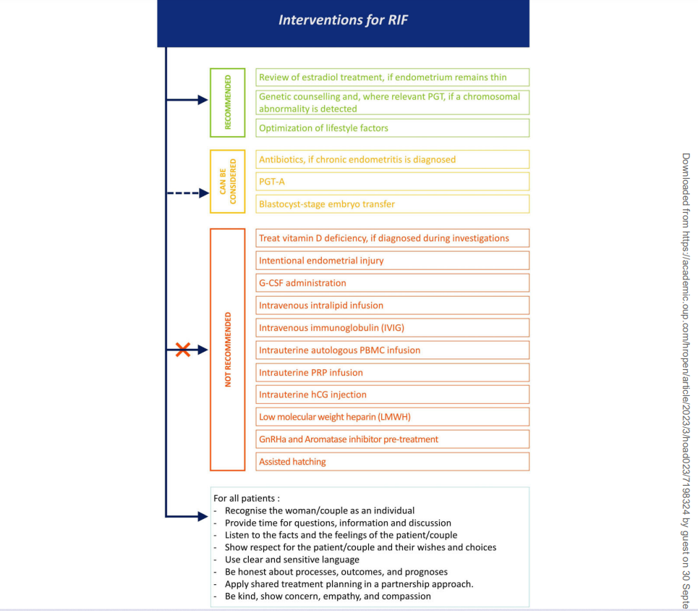

Slide 26
Intentional endometrial injury:
Endometrial injury or endometrial scratch is performed to improve the receptivity of the endometrium towards the transferred embryo. The biological mechanism of action is not fully understood.
A Cochrane review on endometrial injury in women undergoing IVF reported no significantly increased chance of pregnancy and LBR in women with RIF who underwent endometrial injury s (Lensen et al., 2021
To date, studies about endometrial injury that could represent a relevant therapy are not yet established.
Intentional endometrial injury is not recommended.

Slide 27
Intrauterine platelet-rich plasma infusion:
PRP is an autologous concentrate of platelets in plasma. Cytokines and growth factors present in PRP are considered to exert a regenerative effect on tissues and cells, including the endometrial lining (Mouanness et al., 2021).
There is controversial result for efficacy of PRP
A meta-analysis of 16 studies, it was concluded that among different immunomodulatory therapies evaluated in RIF, PRP was the most effective treatment towards improving LBR (Liu et al., 2022a).
Aghajanzadeh et al. (2020) reported from a study of 30 patients with RIF that there is no significant improvement in the implantation or OPR of frozen-thawed embryo recipients treated with PRP as compared to previous cycles without PRP (implantation rate 6.7% versus 0.0%, with or without PRP)
Comprehensive data regarding side effects, complications, and adverse pregnancy outcomes were not available. Furthermore, PRP is characterized by its absolute platelet concentration, which is any concentration above that of whole blood, causing wide variance between studies. Information regarding PRP preparation in individual studies is insufficiently reported (Maleki-Hajiagha et al., 2020). Consensus on the method of platelet isolation and platelet concentration is imperative for clinical implementation. Overall, the evidence available is not considered sufficient to support the use of PRP infusions.
Intrauterine platelet-rich plasma (PRP) infusion is not recommended.

Slide 28
Intrauterine autologous peripheral blood mononuclear cells infusion :
The rationale supporting this treatment is the local production of cytokines by such stimulated peripheral blood mononuclear cells (PBMCs), which could improve blastocyst invasion into the endometrium
A meta-analysis of studies with RIF patients experiencing 3 failed ETs showed a beneficial effect of intrauterine PBMCs infusion with regard to LBR and PR (RR 1.93; 95% CI 1.35–2.76; P < 0.001; 1 RCT þ 3 studies and RR 1.92; 95% CI 1.48–2.49; P < 0.001; 2 RCTs and 6 quasi-experimental studies) (MalekiHajiagha et al., 2019). Two more recent RCTs and one study confirmed these findings (Chakrabarti et al., 2019; Nobijari et al., 2019; Pourmoghadam et al., 2020).
Comprehensive data regarding side effects, complications, and adverse pregnancy outcomes are not available.
Taken together, while a role for PBMCs in specific patients with RIF might be identified, at present their empirical use is not recommended.
Intrauterine autologous peripheral blood mononuclear cells (PBMCs) infusion is not recommended.

Slide 29
Low molecular weight heparin:
LMWH was found to have a significant impact on LBR in women with acquired thrombophilia and showed that the anticoagulation effect of heparin prevents placental thrombosis and infarction, and promotes the continuation of pregnancy
Considering a possible association of thrombophilia with RPL and RIF, the use of LMWH has been expanded to these patients undergoing ART, even in the absence of acquired or inherited thrombophilia.
A meta-analysis investigated the use of LMWH in patients with RIF (3 failed ET) but failed to show an effect of LMWH on LBR and CPR (Busnelli et al., 2021).
The observational study by Berker et al. (2011) also failed to show a difference in LBR or PR.
The included studies had small study populations including a mix of patients with RIF, some with thrombophilia and some who were not tested or negative for thrombophilia (Potdar et al., 2013; Siristatidis et al., 2018; Busnelli et al., 2021).
LMWH has a good safety profile in pregnancy, even if it may cause bruising and bleeding.
Currently there is insufficient data to recommend routine use of LMWH or aspirin in RIF.
Low molecular weight heparin (LMWH) is not recommended to increase the chance of pregnancy or live birth in women with RIF

Slide 30
GnRH agonist and aromatase inhibitor pre-treatment:
Considering endometriosis may be an underlying and undiagnosed cause of RIF, it was hypothesized that empirical GnRH agonist and aromatase inhibitor treatment before ET may improve pregnancy outcomes.
In an RCT, 67 women with at least two implantation failures were randomized to receive GnRH agonist (0.1 mg/day) from Day 21 of the cycle preceding frozen-thawed ET. The dose was reduced to 0.05 mg/day from Cycle Day 2. The control group received no GnRH agonist. No significant differences were found in CPR or implantation rate was seen. 10.52%) in the study versus the control group (Davar et al., 2020).
In a retrospective cohort study, infertile patients aged 36–43 years undergoing their third or more ET after autologous IVF or ICSI were included. The study group (n ¼ 290) received a single injection of 3.75 mg long-acting triptorelin acetate on Day 2 of the preceding cycle, followed by hormone replacement therapy (HRT). The control group (n ¼ 194) received HRT only. Clinical pregnancy rate (49.0% versus 35.1%), OPR (37.6% versus 22.7%), and LBR (36.6% versus 22.1%) were significantly higher in the study group compared to controls, respectively. Miscarriage rates did not differ between groups (Pan et al., 2022).
Taken together, while a role for GnRH agonist and aromatase inhibitor pre-treatment in specific patients with RIF might be identified, at present, their empirical use is not recommended.
GnRH agonist and aromatase inhibitor pre-treatment is not recommended in RIF.

Slide 31
Conclusion:
Experience of unproven treatment should be use limited and carefully to avoid risk for patients .
Further evaluation of embryo- endometrium cross talk and ideal timing of transfer may lead to improve theirs pregnancy outcomes.
The physicians must carefully review the prior diagnostic work up, complete appropriate investigation and offer empathy and encouragement and counsel the success rate for RIF patients.

Slide 32
Thanks for your attention

